Slide 1

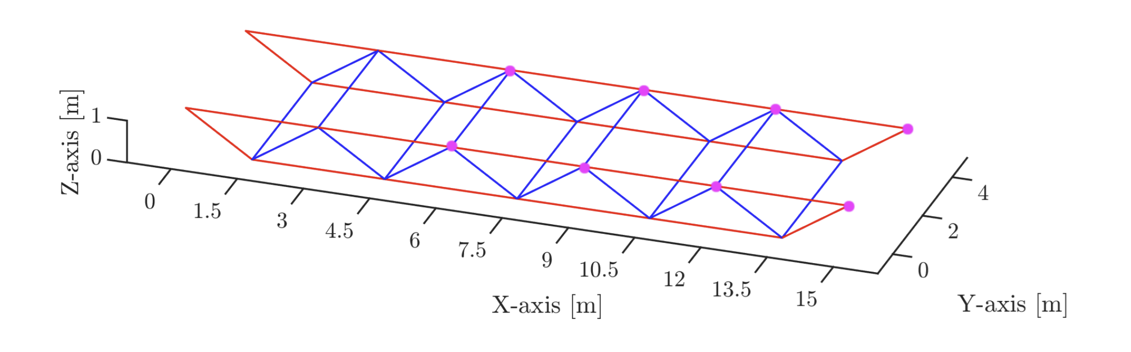
Analysis of the dynamic behavior of a steel canopy
Group 16
Tom Beauve, Lilian Steimetz

Slide 2
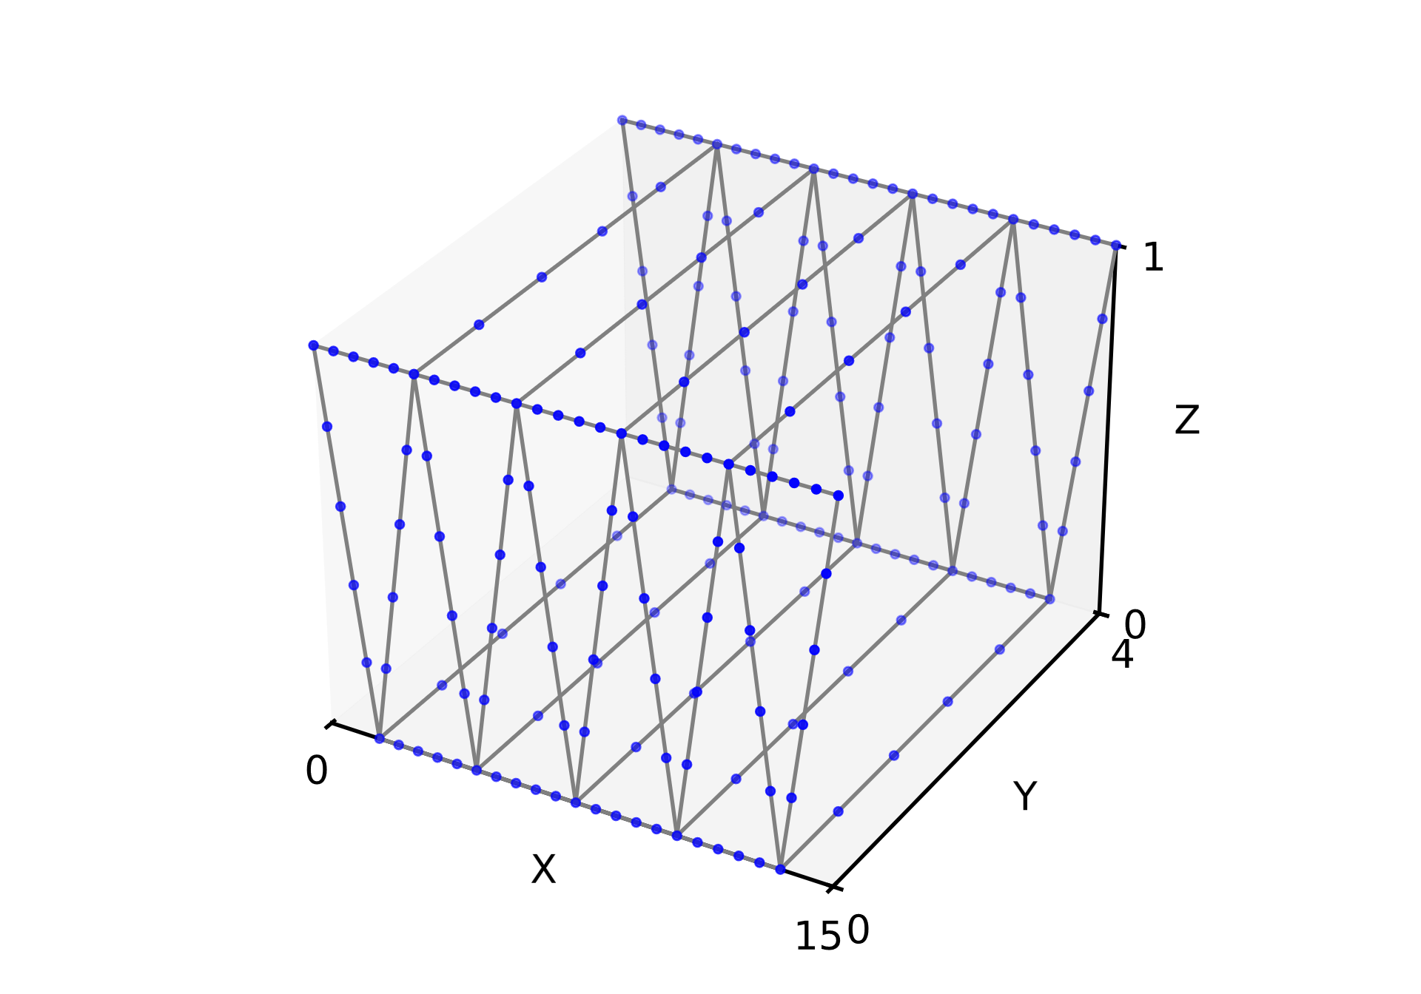
Modeling strategy
Equal (variable) number of elements per beam
NX model : Timochenko beam elements
Python model : Euler-Bernoulli beam elements (shear neglected)
Total mass (using RBM in translation) : 1681 kg
Equal mass for both models
Python model with 5 elements per beam

Slide 3
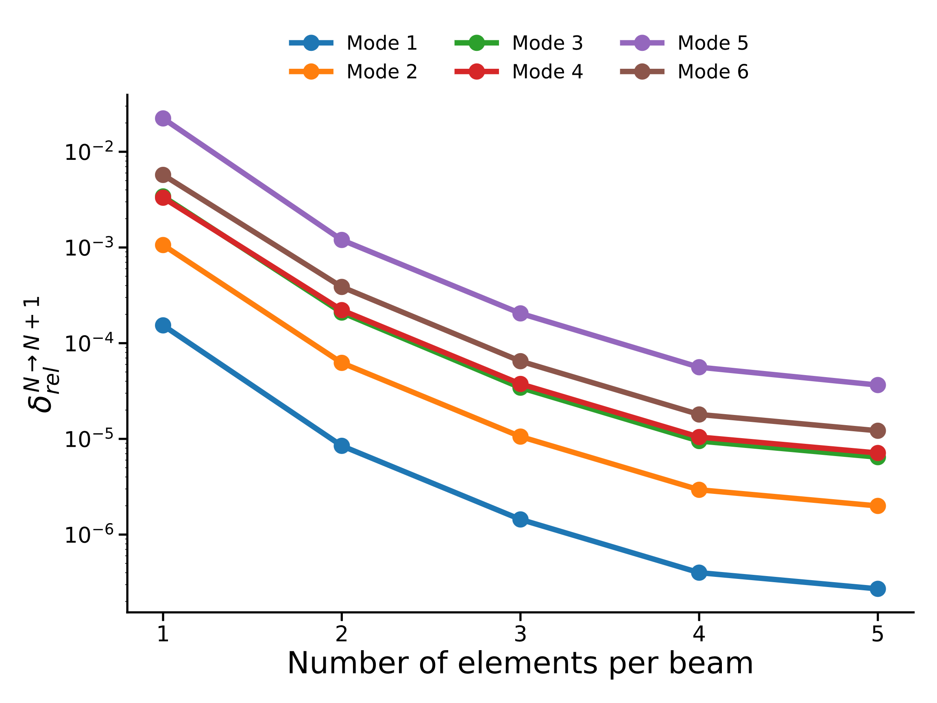
Modal analysis : convergence & comparison of the 2 models
Convergence after 5 elements per beam
Python model consistently stiffer than NX (Euler-Bernoulli vs Timoshenko)
Natural frequencies for 10 elements per beam :
Model | Mode 1 | Mode 2 | Mode 3 | Mode 4 | Mode 5 | Mode 6
Python (Hz) | 2.573 | 6.844 | 10.856 | 12.916 | 13.866 | 14.877
NX (Hz) | 2.569 | 6.827 | 10.816 | 12.864 | 13.856 | 14.816
Rel. Error (%) | 0.14 | 0.25 | 0.36 | 0.40 | 0.07 | 0.41

Slide 4
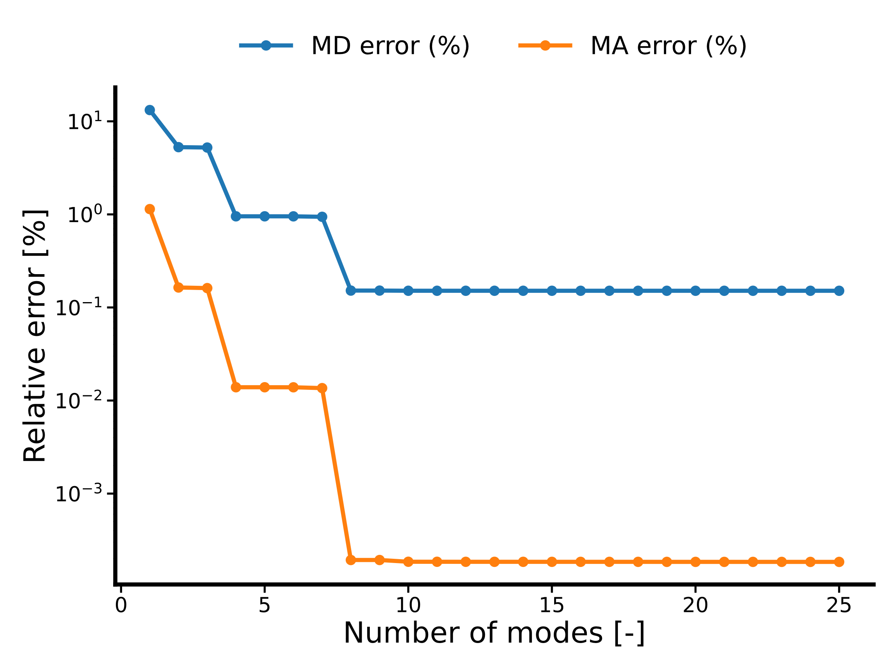
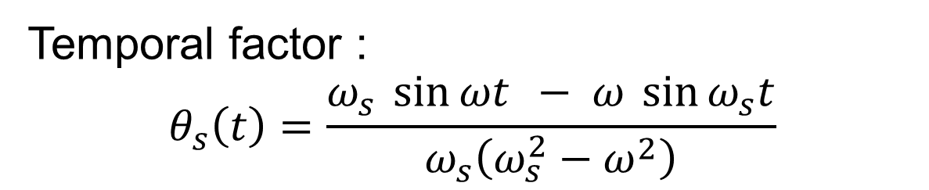
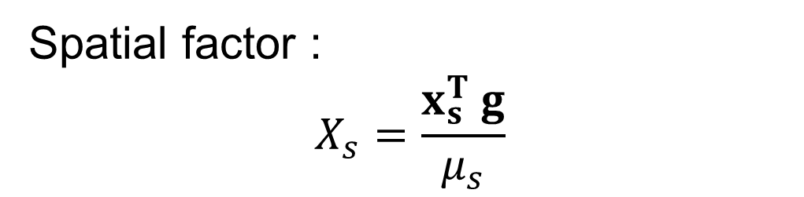
Stationary response : MD and MA comparison
Spatial factor :
$$X_{s}=\frac{x_{s}^{T} g}{μ_{s}}$$
Temporal factor :
$$θ_{s}\left(t\right)=\frac{ω_{s} \sin{ωt} − ω \sin{ω_{s}t}}{ω_{s}\left(ω_{s}^{2}−ω^{2}\right)}$$

Slide 5
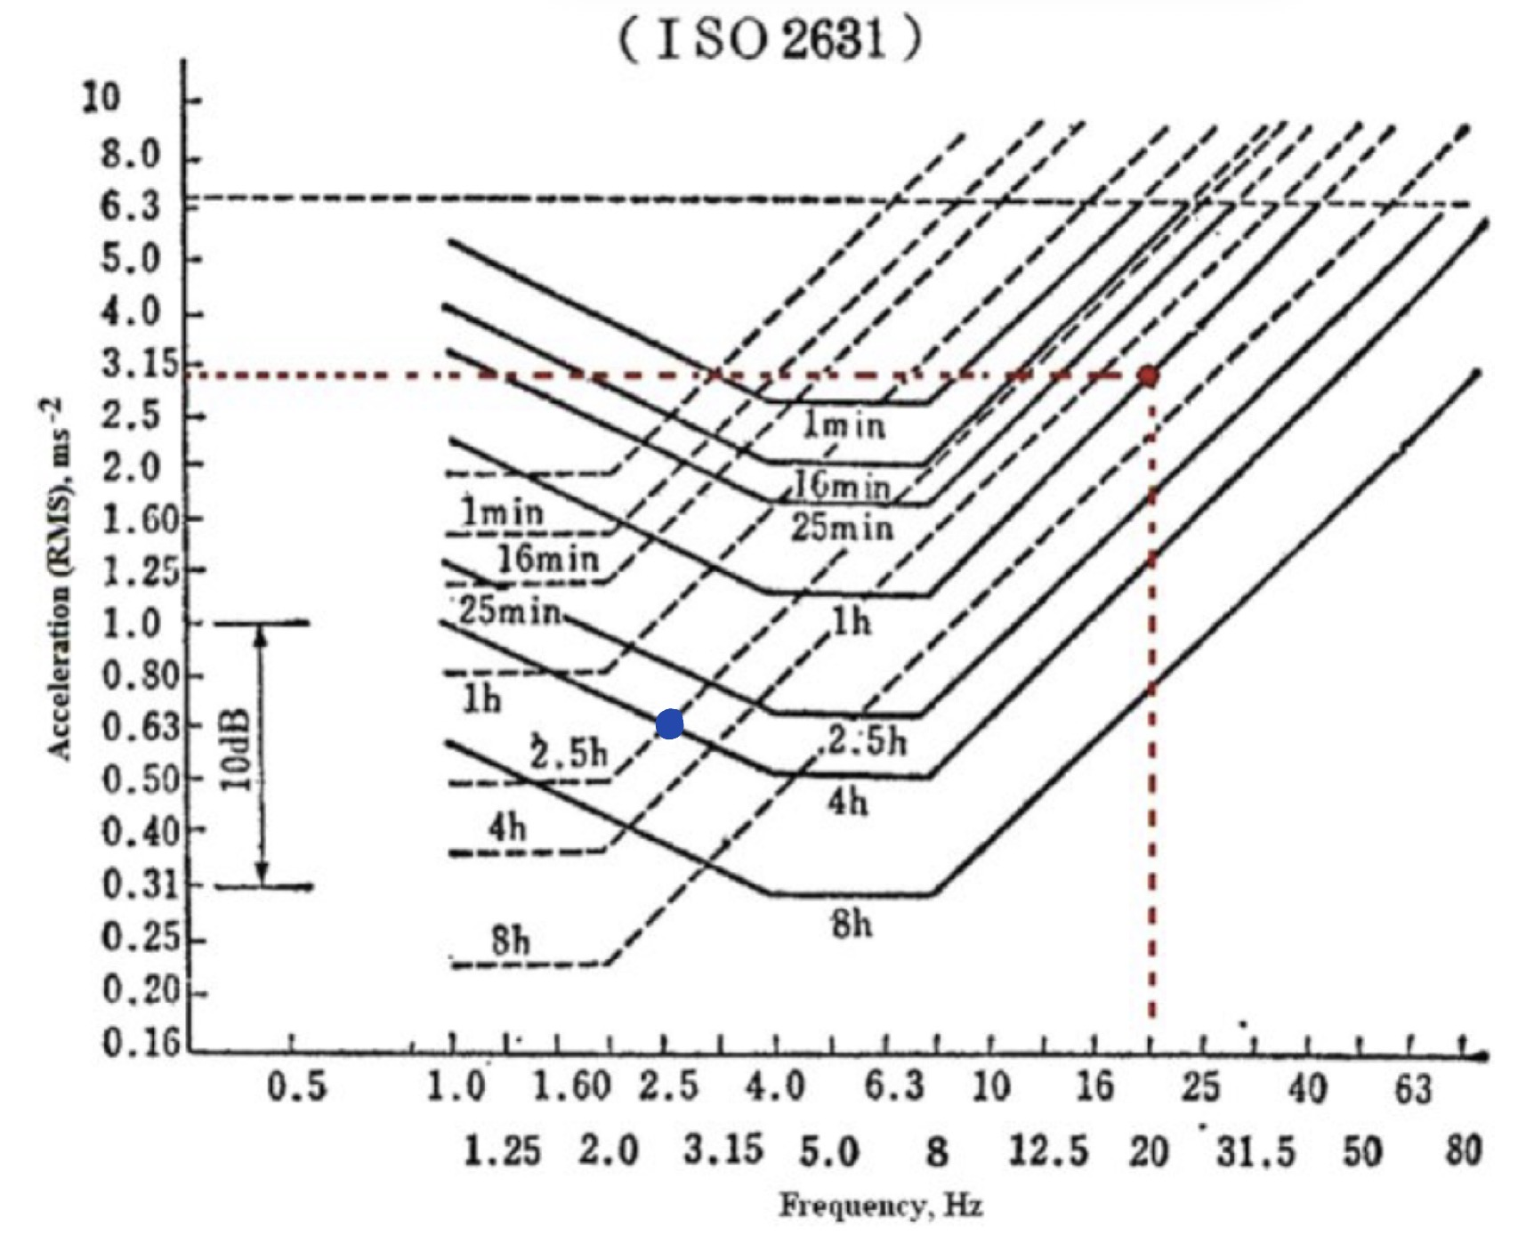

Comfort level
RMS value : $\sqrt{\overline{f^{2}}}=\frac{A}{\sqrt{2}}=0,6560{\text{m}\text{/}\text{s}}^{2}$
ISO2631 :

Slide 6
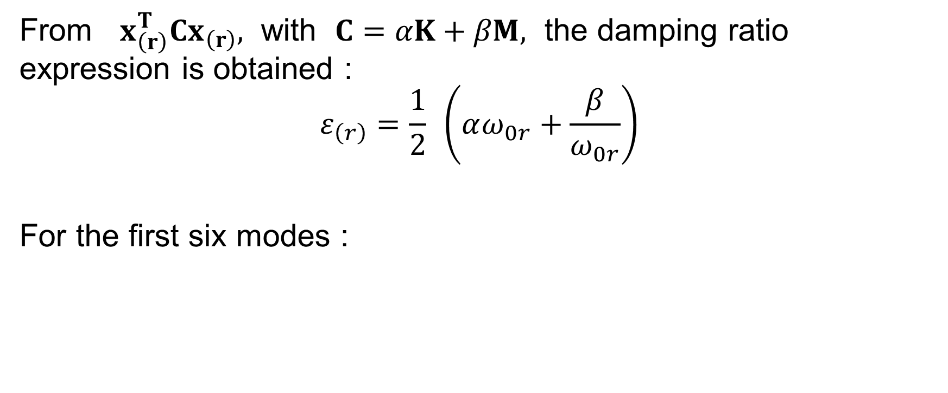
Damping ratios
From $x_{\left(r\right)}^{T}Cx_{\left(r\right)},$ with $C=αK+βM,$ the damping ratio expression is obtained :
$$ε_{\left(r\right)}=\frac{1}{2} \left(αω_{0r}+\frac{β}{ω_{0r}}\right)$$
For the first six modes :
Mode [-] | 1 | 2 | 3 | 4 | 5 | 6
Damping ratio [-] | 0,010 | 0,010 | 0,013 | 0,015 | 0,016 | 0,017

Slide 7
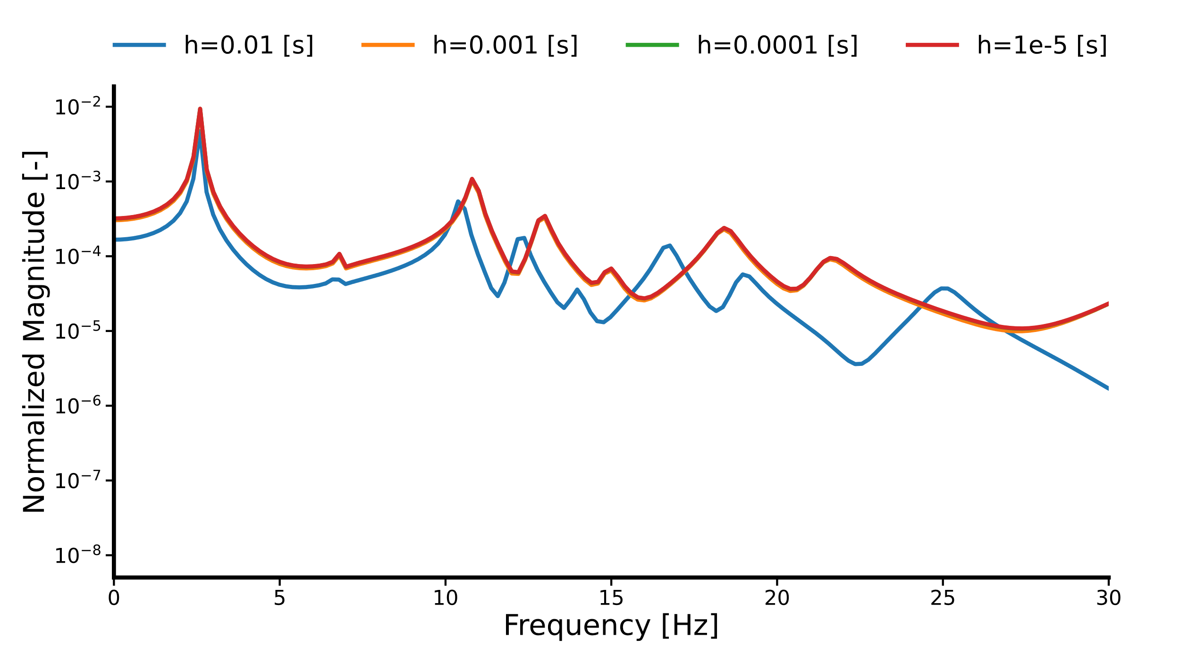
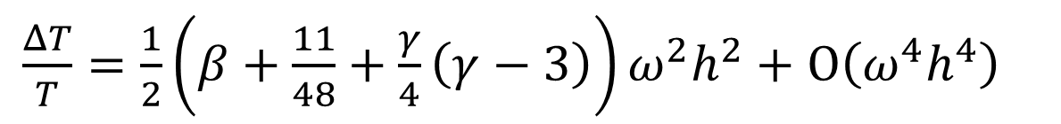

Newmark algorithm : Integration parameters
$$γ= 0,5, β= 0,25$$
$\frac{ΔT}{T}=\frac{1}{2}\left(β+\frac{11}{48}+\frac{γ}{4}\left(γ−3\right)\right)ω^{2}h^{2}+Ο\left(ω^{4}h^{4}\right)$

Slide 8
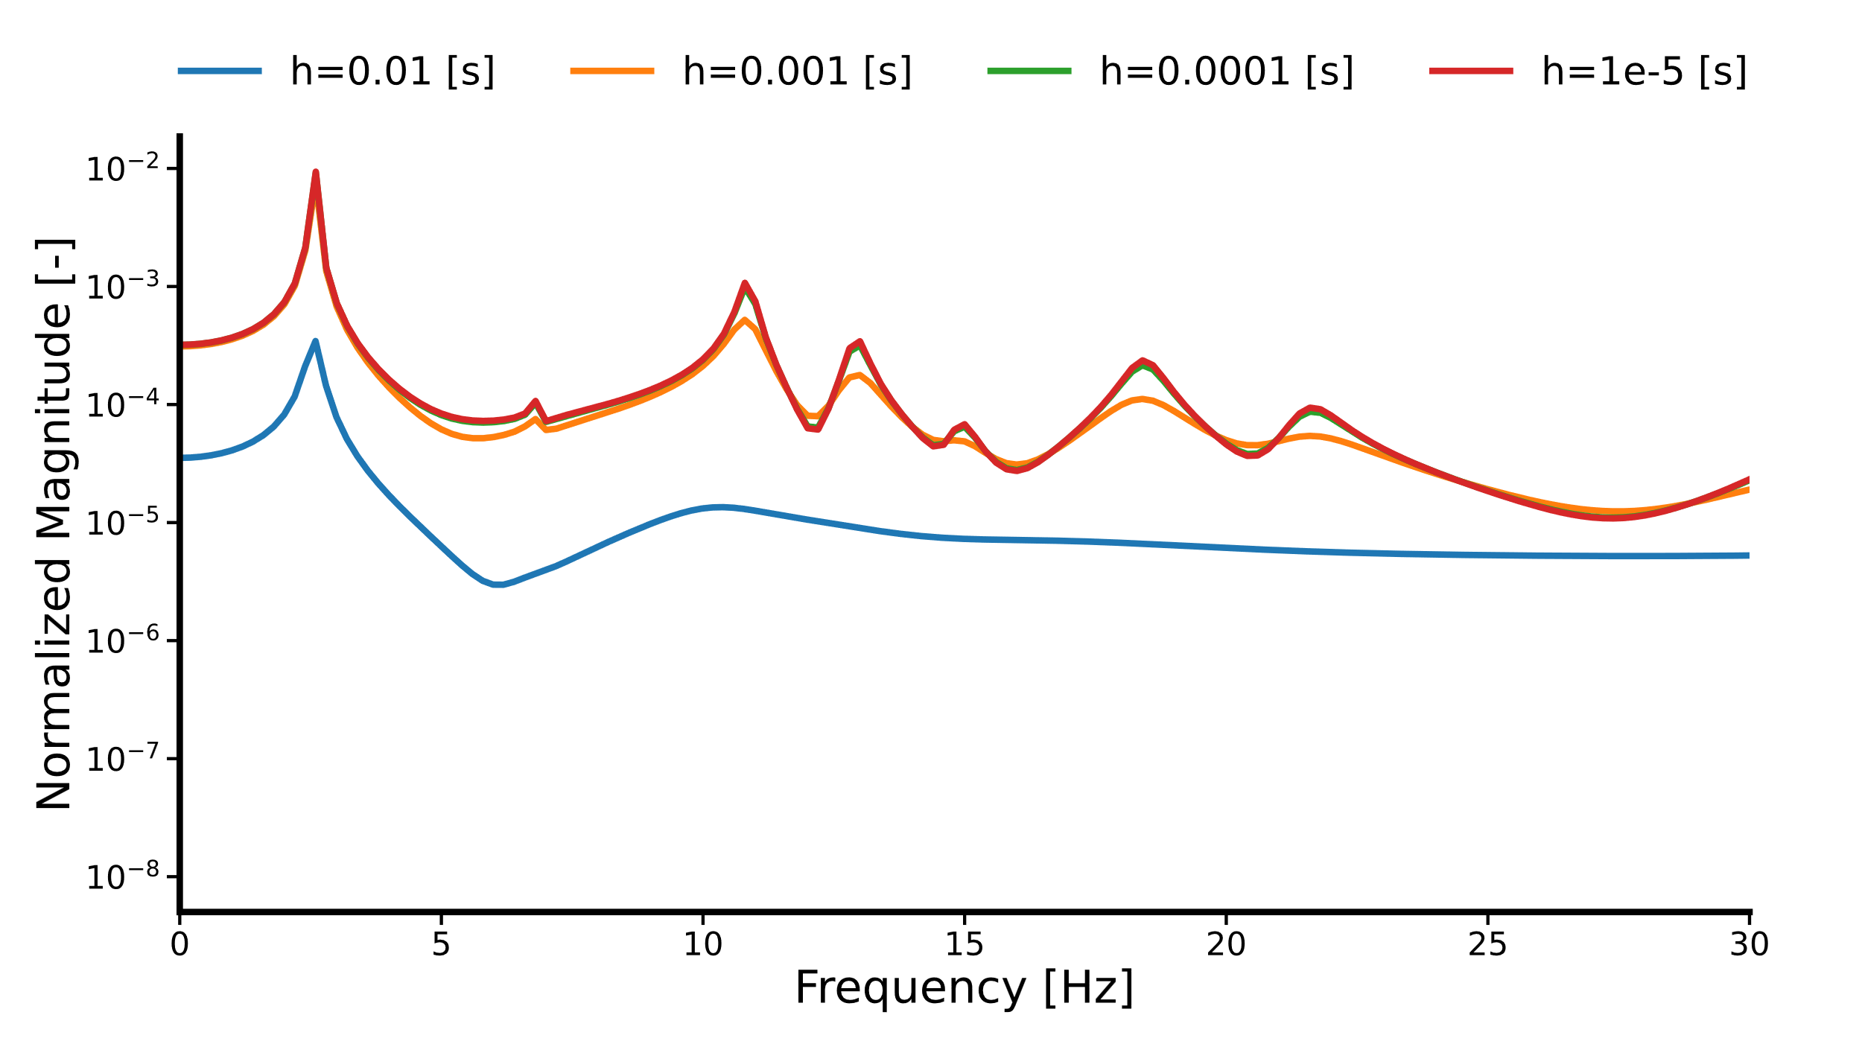
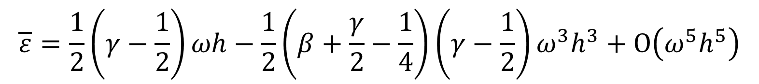
Newmark algorithm : Integration parameters
$$γ= 0,91 , β= 0,5$$
$$\overline{ε}=\frac{1}{2}\left(γ−\frac{1}{2}\right)ωh−\frac{1}{2}\left(β+\frac{γ}{2}−\frac{1}{4}\right)\left(γ−\frac{1}{2}\right)ω^{3}h^{3}+Ο\left(ω^{5}h^{5}\right)$$

Slide 9
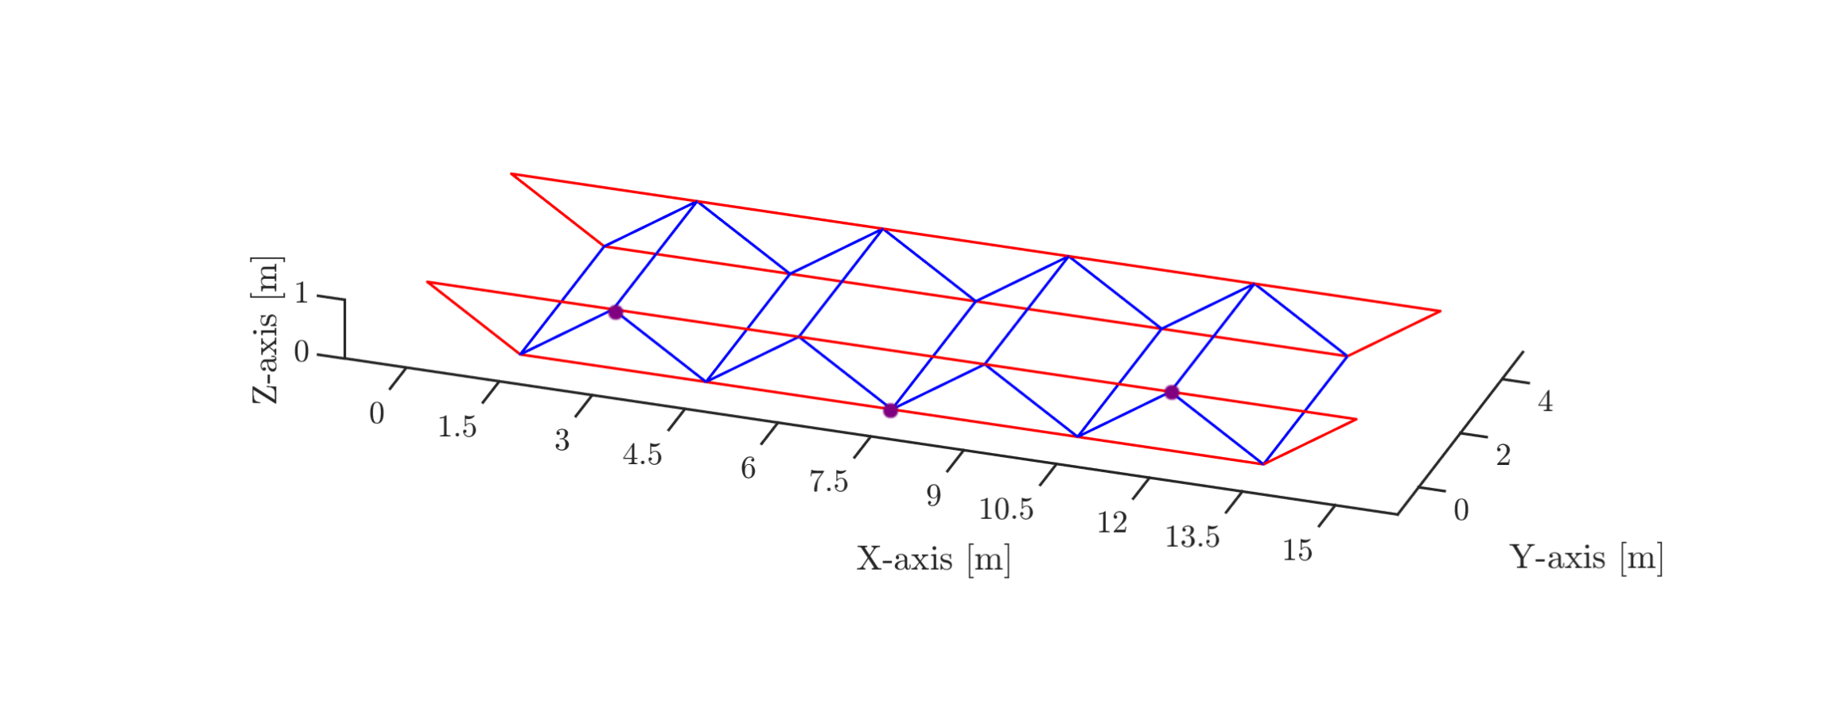
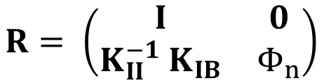
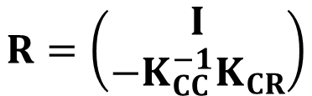

Reduction methods
Reduction matrix R given by
•
$$x=Rx_{R}$$
•
•
Guyan-Irons (static condensation):
$$R=\left(\begin{aligned}I \\ −K_{CC}^{−1}K_{CR}\end{aligned}\right)$$
Craig-Bampton :
$$R= \left(\begin{matrix}I & 0 \\ K_{II}^{−1} K_{IB} & Φ_{n}\end{matrix}\right)$$
Adjustable accuracy

Slide 10
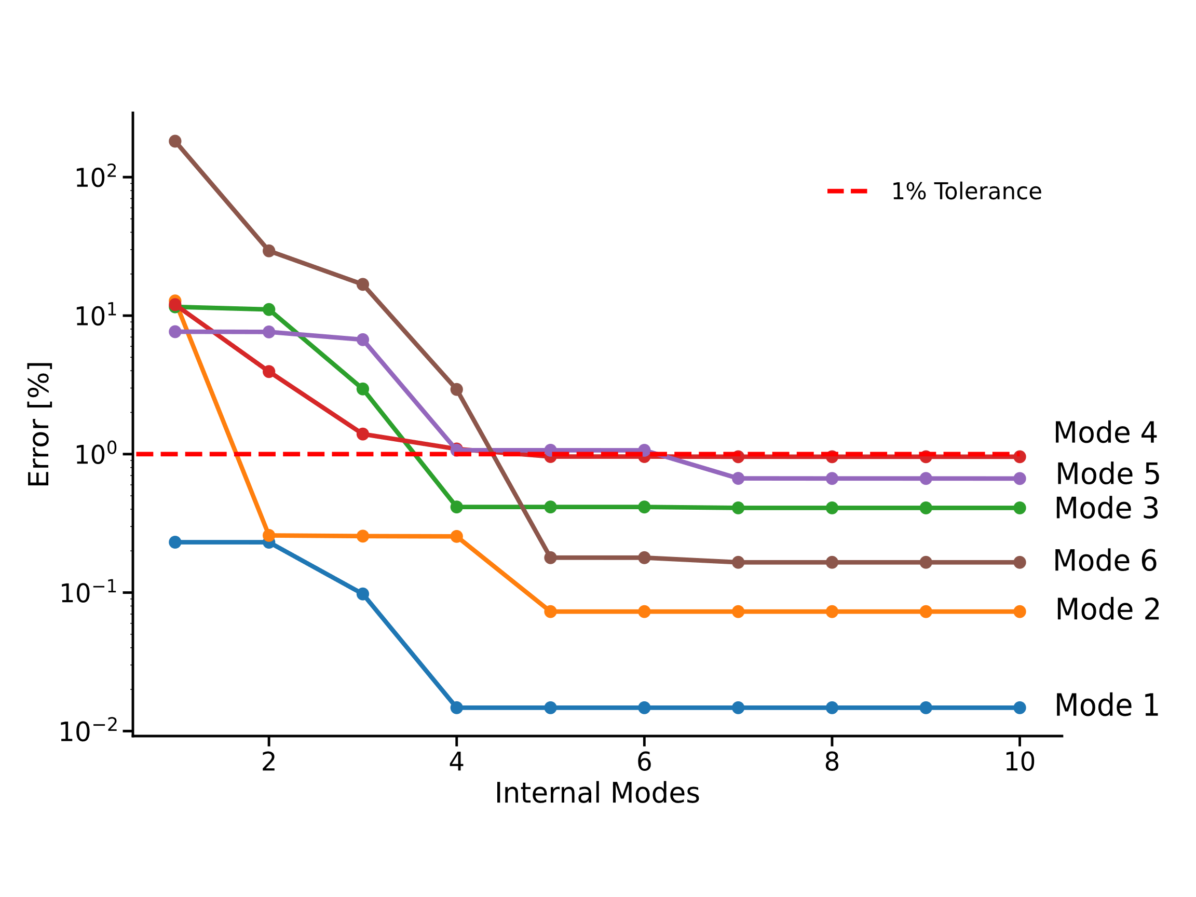
Craig-Bampton accuracy

Slide 11
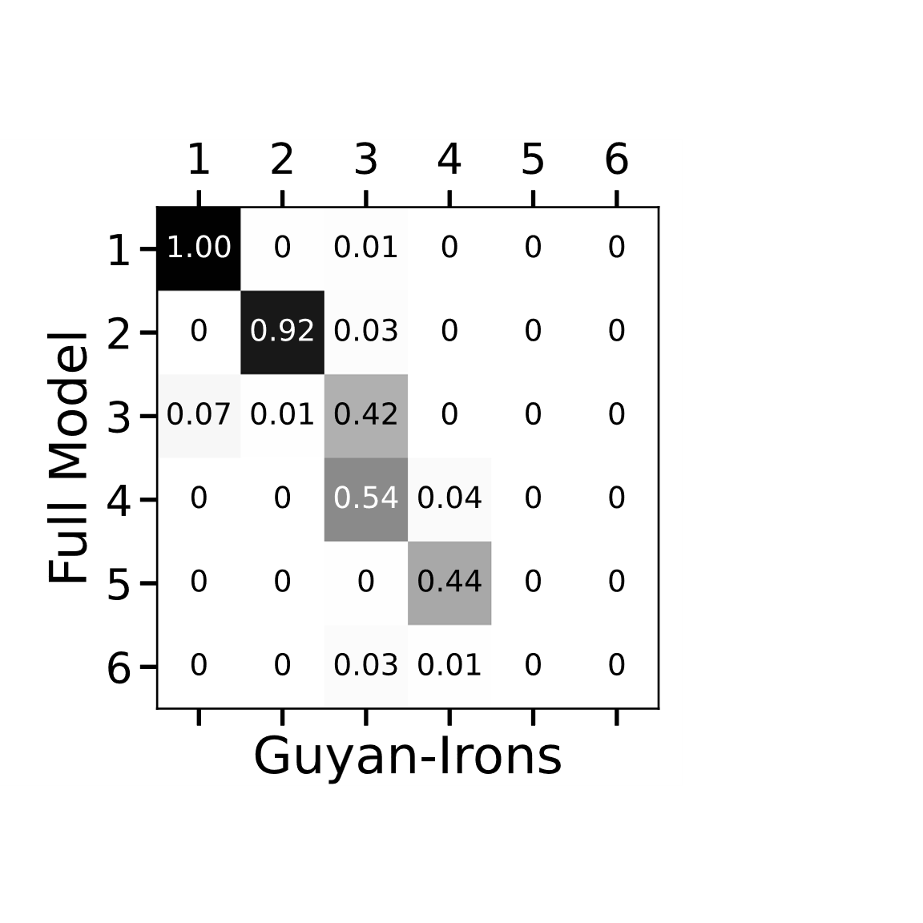
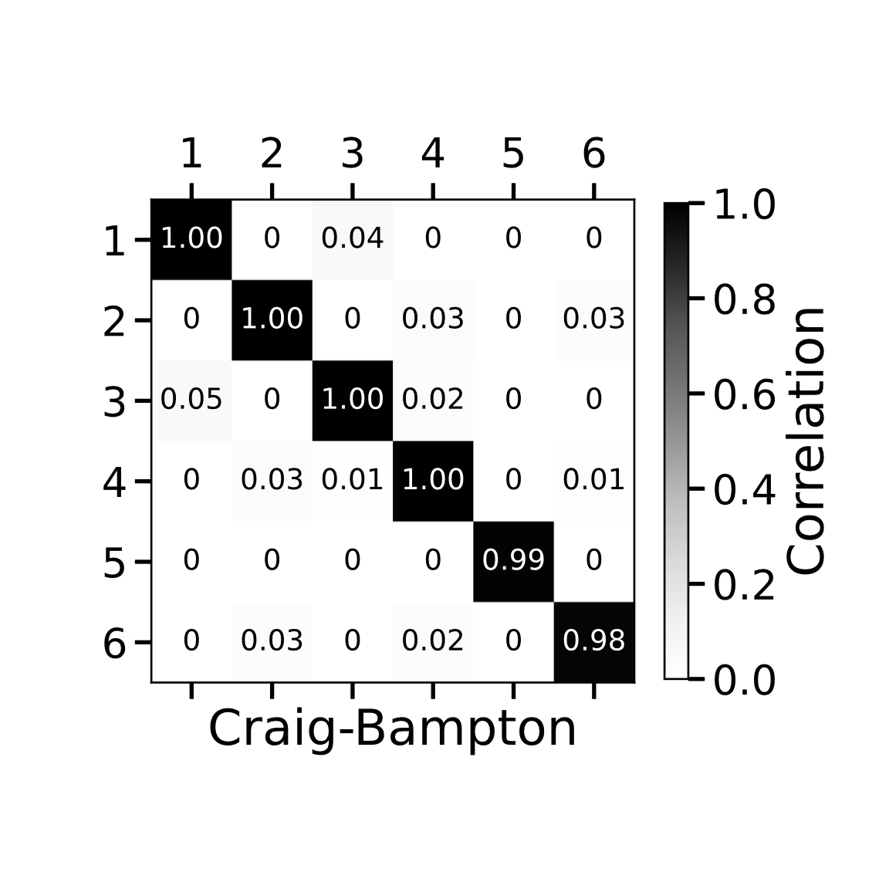
Modal Analysis Comparison
Relative error (%) | Mode 1 | Mode 2 | Mode 3 | Mode 4 | Mode 5 | Mode 6
C-B ( 7 modes) | 0.015 | 0.073 | 0.409 | 0.957 | 0.668 | 0.165
G-I | 3.79 | 13.05 | 22.69 | 15.22 | 202.29 | 427.48

Slide 12
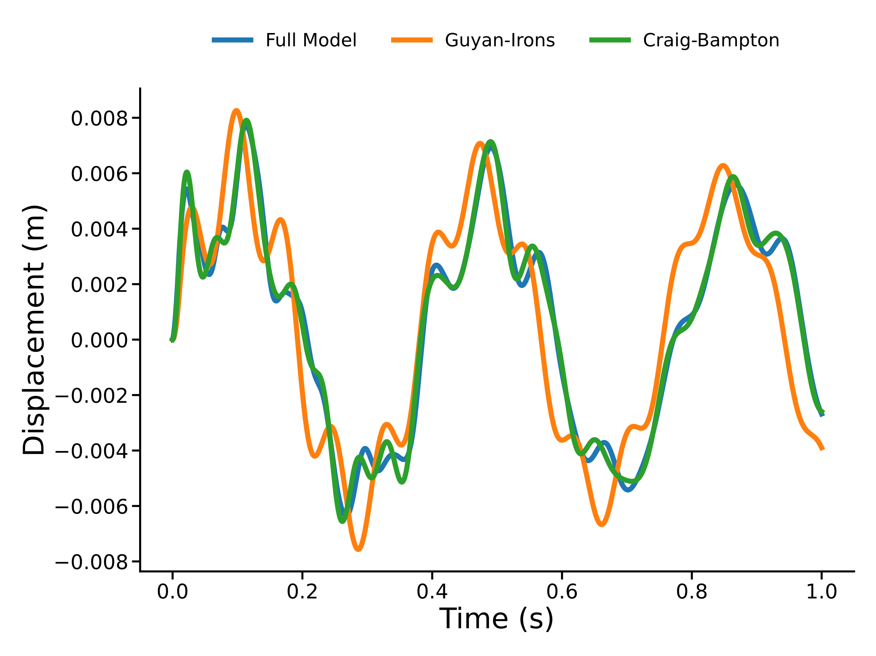
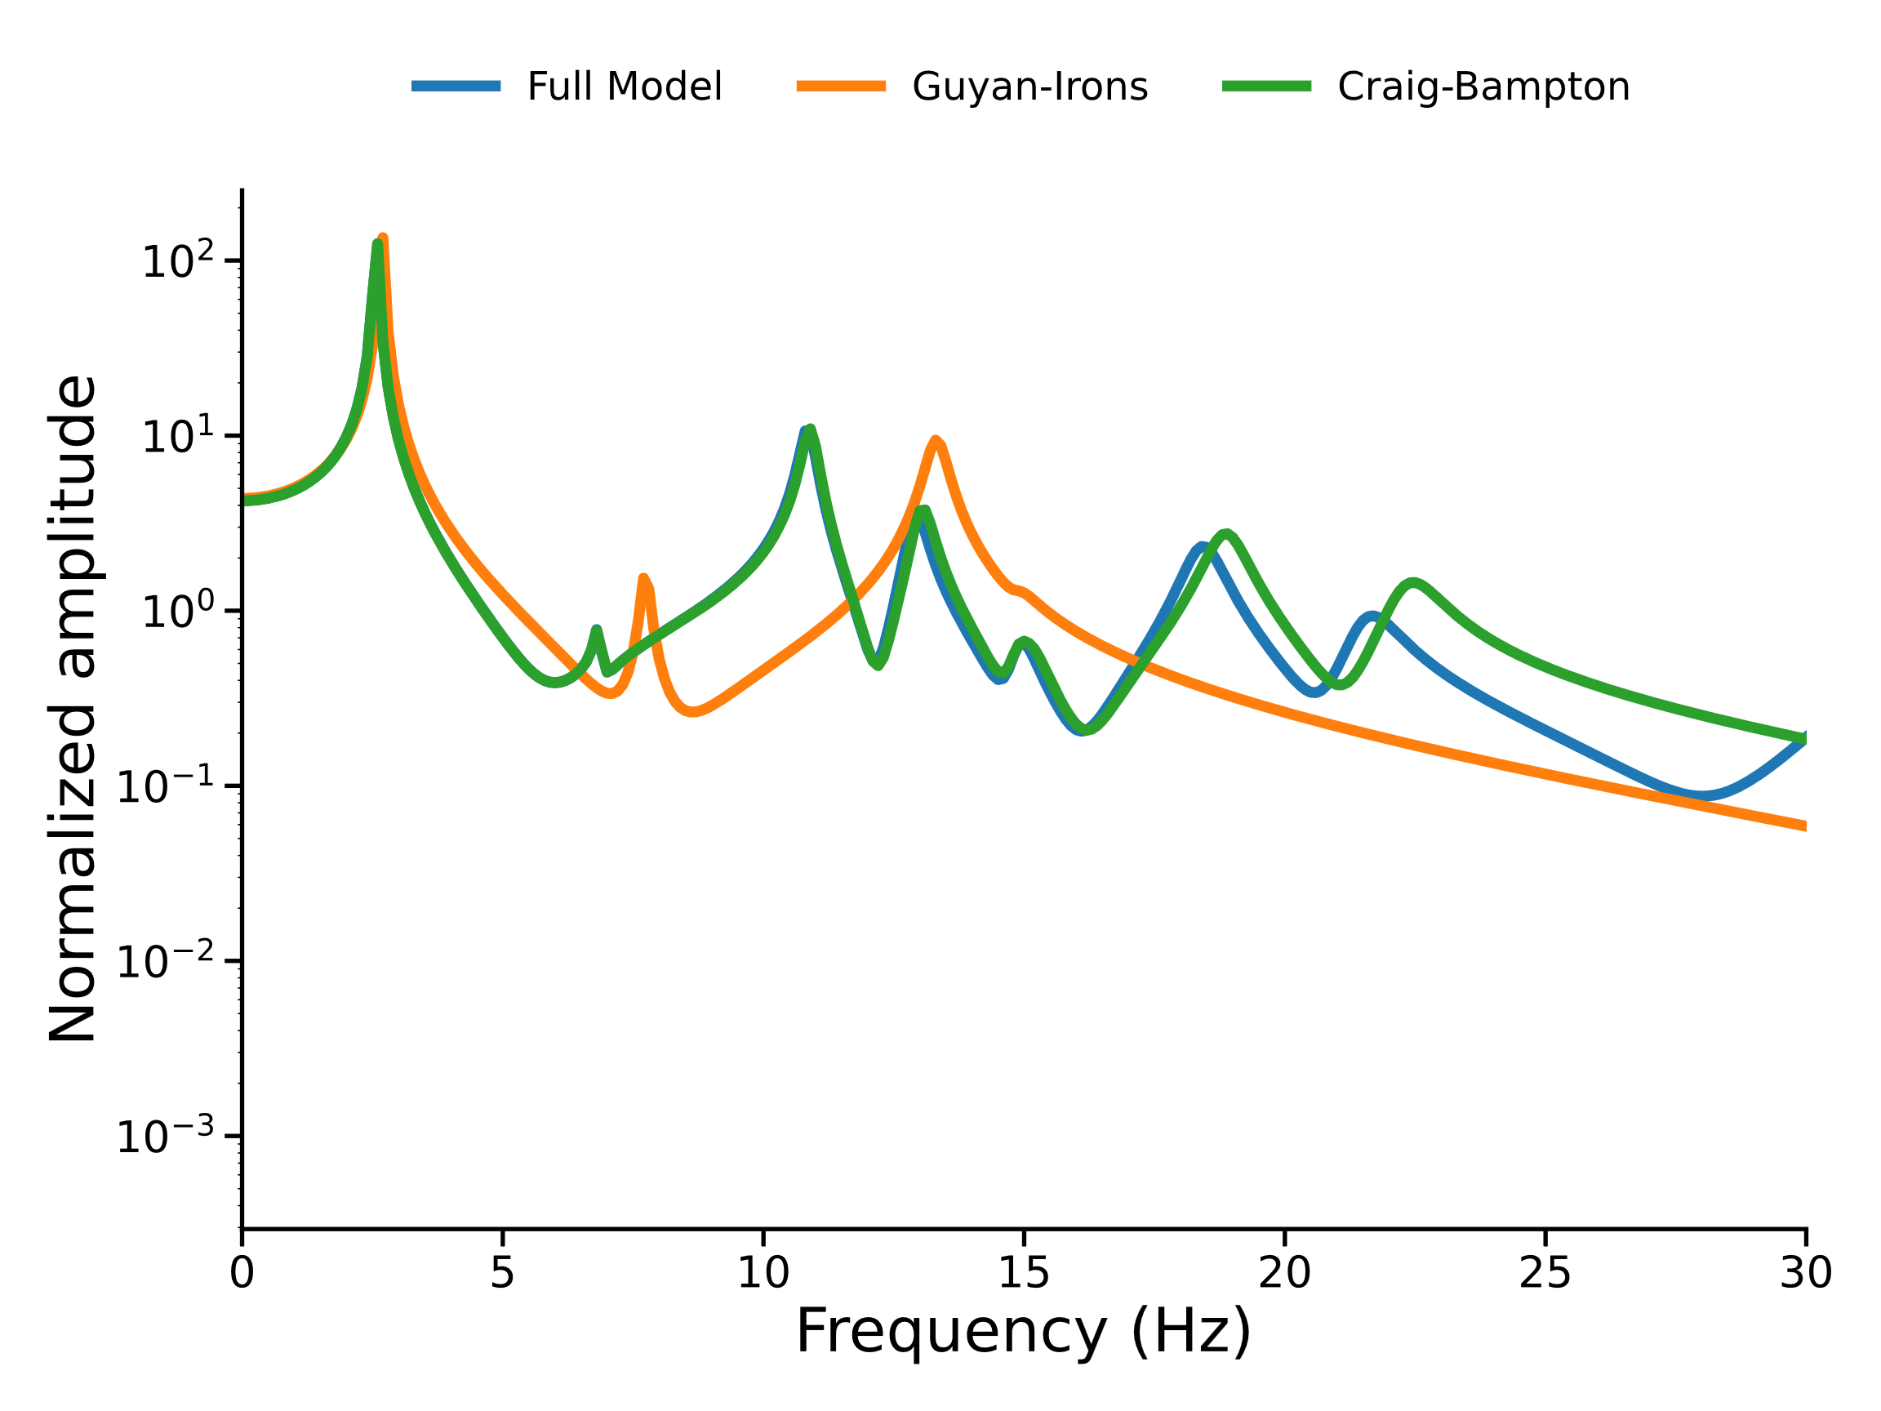
Transient Response Comparison

Slide 13
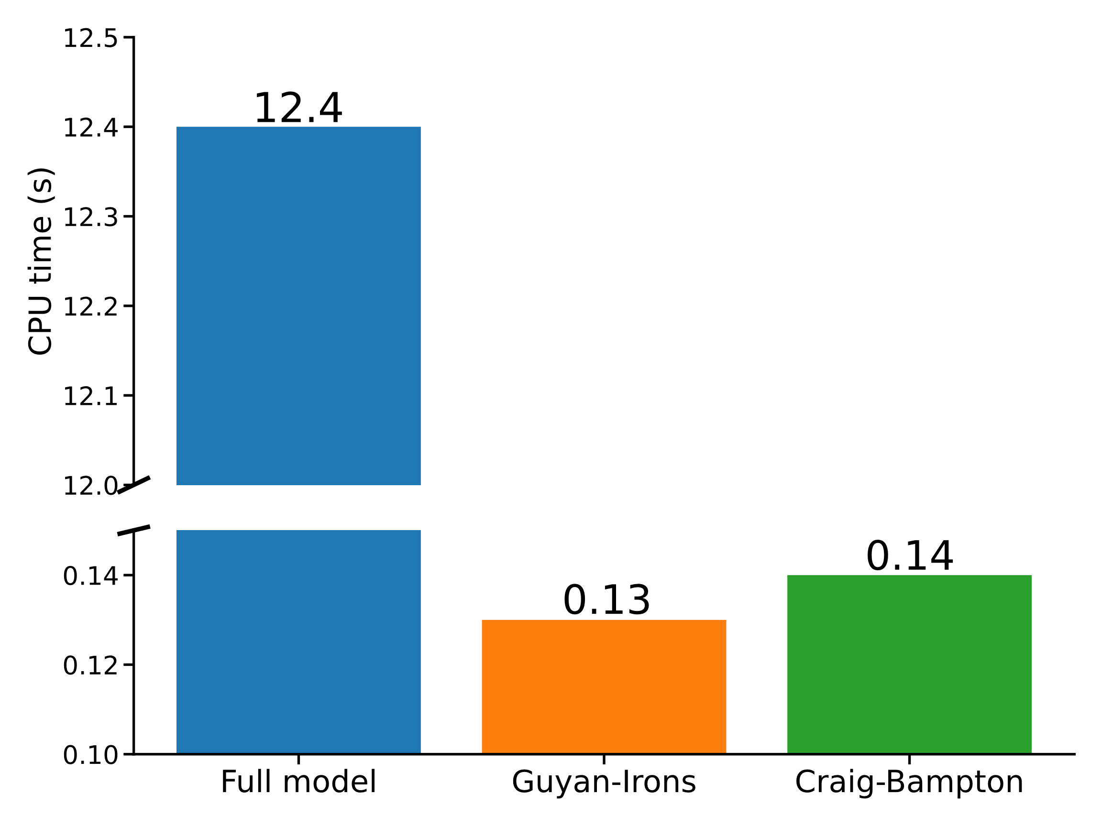
Computational Cost comparison

Slide 14
Conclusion
Modeling : Convergence in 5 elements/beam.
Python stiffer than NX (Euler-Bernoulli).
Approximation methods : MA method has better accuracy with a small number of modes. Performs best for smaller cost.
Newmark algorithm : average constant acceleration scheme performs best. Smaller time step = better accuracy but trade-off with computation time.
Reduction methods : C-B superior in accuracy and “adjustable”, small additional cost.

